Slide 1


CE251: PROGRAMMING IN JAVA
July – November 2020-21
JAVA Exception Handling
Prof. Rima Patel
Assistant Professor

Slide 2

Five keywords
Try block
Catch block
Finally block
Throw
Throws
JAVA Exception Handling

Slide 3
What is Exception Handling
Exception Handling is a mechanism to handle runtime errors such as ClassNotFound, IO, SQL, Remote etc.
JAVA Exception Handling

Slide 4
Advantage of Exception Handling
Why we use exception handling?
to maintain the normal flow of the application
JAVA Exception Handling

Slide 5
Example
statement 1;
statement 2;
statement 3;
statement 4;
statement 5;//exception occurs
statement 6;
statement 7;
statement 8;
statement 9;
statement 10;
JAVA Exception Handling

Slide 6
Meaning
Suppose there are 10 statements in your program and there occurs an exception at statement 5, the rest of the code will not be executed i.e. statement 6 to 10 will not be executed.
If we perform exception handling, the rest of the statement will be executed. That is why we use exception handling in Java.
JAVA Exception Handling

Slide 7
Keyword | Description
try | The "try" keyword is used to specify a block where we should place exception code. The try block must be followed by either catch or finally. It means, we can't use try block alone.
catch | The "catch" block is used to handle the exception. It must be preceded by try block which means we can't use catch block alone. It can be followed by finally block later.
finally | The "finally" block is used to execute the important code of the program. It is executed whether an exception is handled or not.
throw | The "throw" keyword is used to throw an exception.
throws | The "throws" keyword is used to declare exceptions. It doesn't throw an exception. It specifies that there may occur an exception in the method. It is always used with method signature.
JAVA Exception Handling

Slide 8
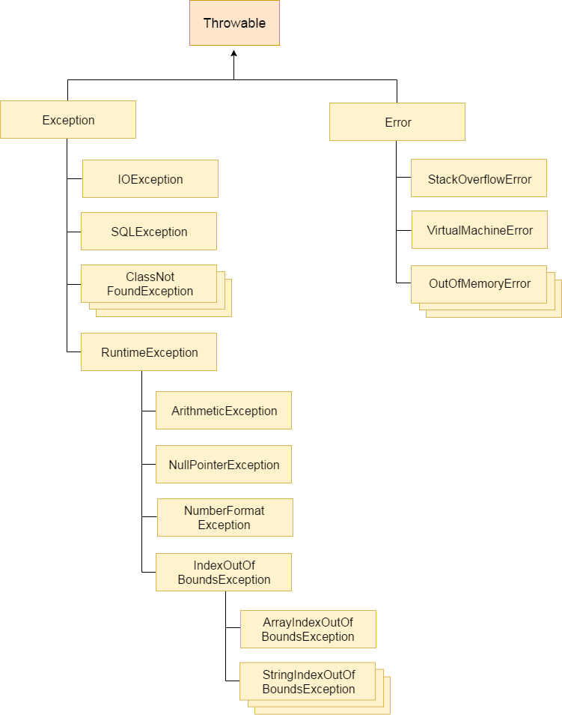
Hierarchy of Java Exception classes
JAVA Exception Handling

Slide 9
Types of Java Exceptions
1. Checked Exception
2. Unchecked Exception
3. Error
JAVA Exception Handling

Slide 10
First Discuss Unchecked Exception
class UncheckedException
{
P.S.V.M()
{
S.O.P(“Hello”);
S.O.P(“Hiiiii”);
S.O.P(10/0);
S.O.P(“Hello”);
S.O.P(“Hiiiii”);
}
}
// arithmetic exception
Program will compile & executed abnormally
JAVA Exception Handling

Slide 11
Unchecked Exception
The exception which are not checked by compiler is called unchecked exception.
Application contain unchecked exception code is compiled but run time JVM show exception.
We can handle such type of exception using try-catch or throws keyword
JAVA Exception Handling

Slide 12
Example-2
class UncheckedException
{
P.S.V.M()
{
int[] a = {10,20,30,40};
S.O.P(a[0]);
S.O.P(a[10]);
}
}
// array index out of bound exception
This is the type of unchecked exception
JAVA Exception Handling

Slide 13
Example-3
class UncheckedException
{
P.S.V.M()
{
String str = “Charusat”;
S.O.P(str.chaAt(2));
S.O.P(str.chaAt(20);
}
}
// string index out of bound exception
This is the type of unchecked exception
JAVA Exception Handling

Slide 14
Example-4
class UncheckedException
{
P.S.V.M()
{
String str = null;
S.O.P(str.length());
}
}
// Null pointer exception
This is the type of unchecked exception
JAVA Exception Handling

Slide 15
checked exception
The classes which directly inherit Throwable class except RuntimeException and Error are known as checked exceptions e.g. IOException, SQLException etc. Checked exceptions are checked at compile-time.
Java forces you to handle these error scenarios in some manner in your application code. They will come immediately into your face, once you start compiling your program.
JAVA Exception Handling

Slide 16
Understand checked exception
public static void main(String[] args)
{
FileReader file = new FileReader("somefile.txt");
}
//File not found exception
Program will not compile, compiler check exception and write try-catch block.
JAVA Exception Handling

Slide 17
public static void main(String[] args)
{
try
{
FileReader file = new FileReader("somefile.txt");
}
catch (FileNotFoundException e)
{
//Alternate logic
e.printStackTrace();
}
}
JAVA Exception Handling

Slide 18
More type of checked exception
checked exceptions e.g. IOException, SQLException etc.
Checked exceptions are checked at compile-time.
JAVA Exception Handling

Slide 19
Error
An error is considered as the unchecked exception.
Error is irrecoverable
e.g. OutOfMemoryError, VirtualMachineError, AssertionError etc.
JAVA Exception Handling

Slide 20
Try-catch block
Try block is used to enclose the code that might throw an exception
Try block must be used within the method
Java try block must be followed by either catch or finally block.
JAVA Exception Handling

Slide 21
Syntax of java try-catch
try{
//code that may throw exception
}
catch(Exception_class_Name ref){
}
JAVA Exception Handling

Slide 22
Syntax of try-finally block
try{
//code that may throw exception
}
finally{
}
JAVA Exception Handling

Slide 23
Java catch block
Java catch block is used to handle the Exception.
It must be used after the try block only.
You can use multiple catch block with a single try.
JAVA Exception Handling

Slide 24
Example-1
public class TestTryCatch{
public static void main(String args[]){
int data=10/0;
System.out.println("rest of the code...");
}
}
It will throw an exception-
Exception in thread main java.lang.ArithmeticException:/ by zero
JAVA Exception Handling

Slide 25
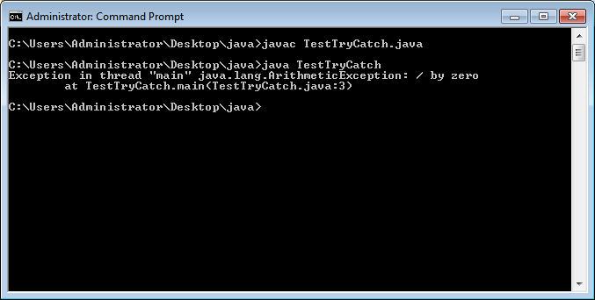
JAVA Exception Handling

Slide 26
Use try-catch block
public class TestTryCatch{
public static void main(String args[]){
try{
int data=10/0;
}
catch(ArithmeticException e)
{ System.out.println(e);
}
System.out.println("rest of the code...");
}
}
By doing this we are able to execute the rest of the statements
JAVA Exception Handling

Slide 27
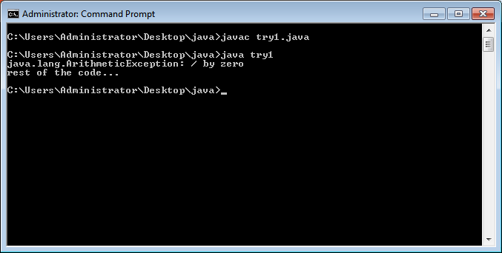
JAVA Exception Handling

Slide 28
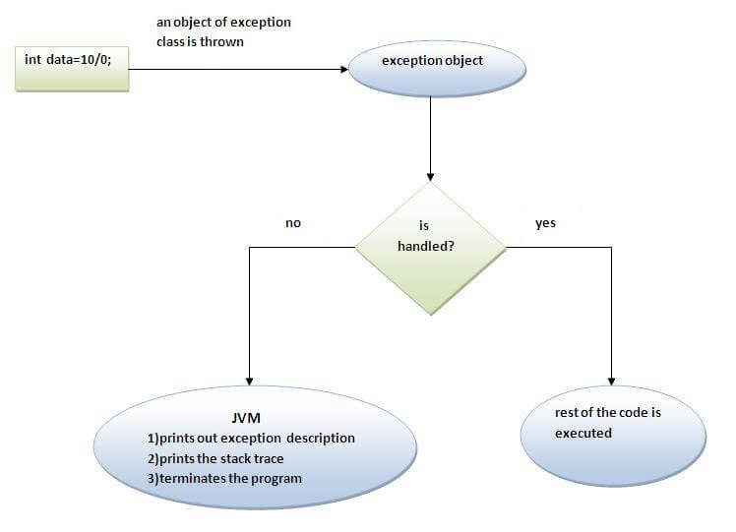
Internal working of try-catch block
JAVA Exception Handling

Slide 29
Java Multi catch block
We want to handle different exception then use multi catch block
Rules
At a time only one exception is occurred & at a time only one catch block is executed
All catch block must be ordered from most specific to most general
JAVA Exception Handling

Slide 30
Example-1
public class TestMultipleCatchBlock{
public static void main(String args[]){
try{
int a[]=new int[5];
a[5]=30/0;
}
catch(ArithmeticException e){
System.out.println("task1 is completed");}
catch(ArrayIndexOutOfBoundsException e){
System.out.println("task 2 completed");}
catch(Exception e){
System.out.println("common task completed");}
System.out.println("rest of the code...");
}
}
Output
task1 completed
rest of the code...
JAVA Exception Handling

Slide 31
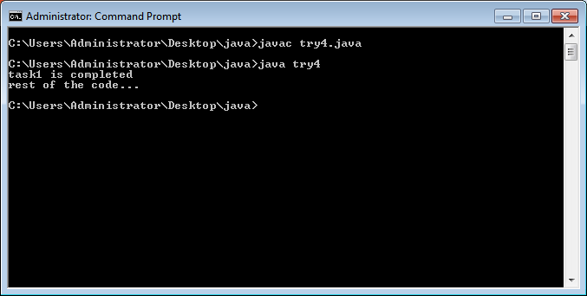
JAVA Exception Handling

Slide 32
Example-2 What is the output here
public class TestMultipleCatchBlock{
public static void main(String args[]){
try{
int a[]=new int[5];
a[5]=30/0;
}
catch(Exception e){
System.out.println("common task completed");}
catch(ArithmeticException e){
System.out.println("task1 is completed");}
catch(ArrayIndexOutOfBoundsException e){
System.out.println("task 2 completed");}
System.out.println("rest of the code...");
}
}
Output
Compile-time error
JAVA Exception Handling

Slide 33
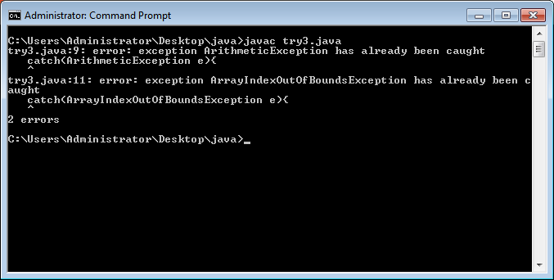
JAVA Exception Handling

Slide 34
public class MultipleCatchBlock2 {
public static void main(String[] args) {
try{
int a[]=new int[5];
System.out.println(a[10]);
}
catch(ArithmeticException e)
{
System.out.println("Arithmetic Exception occurs");
}
catch(ArrayIndexOutOfBoundsException e)
{
System.out.println("ArrayIndexOutOfBounds Exception occurs");
}
catch(Exception e)
{
System.out.println("Parent Exception occurs");
}
System.out.println("rest of the code");
}
}
JAVA Exception Handling

Slide 35
public class MultipleCatchBlock3 {
public static void main(String[] args) {
try{
int a[]=new int[5];
a[5]=30/0;
System.out.println(a[10]);
}
catch(ArithmeticException e)
{
System.out.println("Arithmetic Exception occurs");
}
catch(ArrayIndexOutOfBoundsException e)
{
System.out.println("ArrayIndexOutOfBounds Exception occurs");
}
catch(Exception e)
{
System.out.println("Parent Exception occurs");
}
System.out.println("rest of the code");
}
}
JAVA Exception Handling

Slide 36
public class MultipleCatchBlock4 {
public static void main(String[] args) {
try{
String s=null;
System.out.println(s.length());
}
catch(ArithmeticException e)
{
System.out.println("Arithmetic Exception occurs");
}
catch(ArrayIndexOutOfBoundsException e)
{
System.out.println("ArrayIndexOutOfBounds Exception occurs");
}
catch(Exception e)
{
System.out.println("Parent Exception occurs");
}
System.out.println("rest of the code");
}
}
JAVA Exception Handling

Slide 37
How to handle multiple exception?
Using Nested try block- every try-catch block cause separate error
JAVA Exception Handling

Slide 38
Java Nested try block
try
{
statement 1;
statement 2;
try
{
statement 1;
statement 2;
}
catch(Exception e)
{
}
}
catch(Exception e)
{
}
JAVA Exception Handling

Slide 39
Example
class MultiExcep{
public static void main(String args[]){
try{
try{
System.out.println("divide by zero exception");
int b =10/0;
}catch(ArithmeticException e){System.out.println(e);}
try{
int a[]=new int[5];
a[5]=4;
}catch(ArrayIndexOutOfBoundsException e){System.out.println(e);}
System.out.println("other statement);
}catch(Exception e){System.out.println("handeled");}
System.out.println("normal flow..");
}
}
JAVA Exception Handling

Slide 40
Java finally block
The finally block is always executed irrespective of try-catch block
It is used to execute important code such as closing connection, stream etc.- called cleanup process
Means-
To close the database connection
To destroy the objects
To close the file or channel
JAVA Exception Handling

Slide 41
Case-1 (Normal termination)
class TestFinallyBlock{
public static void main(String args[]){
try{
int data=25/5;
System.out.println(data);
}
catch(NullPointerException e){System.out.println(e);}
finally{
System.out.println("finally block is always executed");}
System.out.println("rest of the code...");
}
}
Output: 5
finally block is always executed
rest of the code...
JAVA Exception Handling

Slide 42
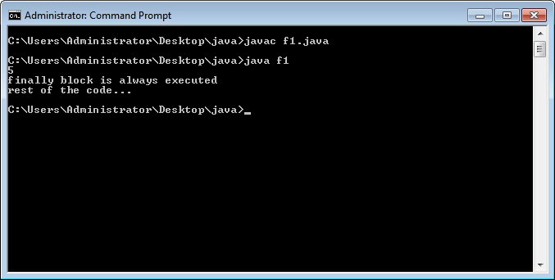
JAVA Exception Handling

Slide 43
Case-2 (normal termination)
class TestFinallyBlock1{
public static void main(String args[]){
try{
int data=10/0;
System.out.println(data);
}
catch(ArithmeticException e){System.out.println(e);}
finally{
System.out.println("finally block is always executed");}
System.out.println("rest of the code...");
}
}
JAVA Exception Handling

Slide 44

JAVA Exception Handling

Slide 45
Case-3 (abnormal termination)
class TestFinallyBlock1{
public static void main(String args[]){
try{
int data=10/0;
System.out.println(data);
}
catch(NullPointerException e){System.out.println(e);}
finally{
System.out.println("finally block is always executed");}
System.out.println("rest of the code...");
}
}
Divide by zero exception but catch not matched
Finally block will be execute
JAVA Exception Handling

Slide 46
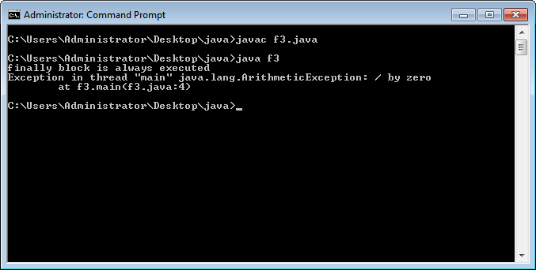
JAVA Exception Handling

Slide 47
Case-4 (abnormal termination)
class TestFinallyBlock1{
public static void main(String args[]){
try{
int data=10/0;
System.out.println(data);
}
catch(ArithmaticException e){System.out.println(10/0);}
finally{
System.out.println("finally block is always executed");}
System.out.println("rest of the code...");
}
}
Divide by zero exception in try and catch
Finally block will be execute
JAVA Exception Handling

Slide 48

JAVA Exception Handling

Slide 49
Case-5 (abnormal termination)
class TestFinallyBlock1{
public static void main(String args[]){
try{
int data=10/0;
System.out.println(data);
}
catch(ArithmaticException e){System.out.println(e);}
finally{
System.out.println(10/0);}
System.out.println("rest of the code...");
}
}
Divide by zero exception catch block execute
Finally block will be executed by AE
JAVA Exception Handling

Slide 50
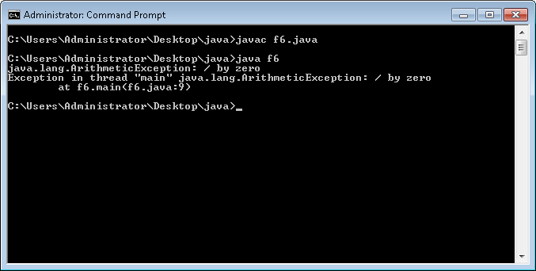
JAVA Exception Handling

Slide 51
Case-6 (normal termination)
class TestFinallyBlock1{
public static void main(String args[]){
try{
int data=100/10;
System.out.println(data);
}
finally{
System.out.println(“finally block”);}
System.out.println("rest of the code...");
}
}
Try block
Finally block
JAVA Exception Handling

Slide 52
Conclusion
In all the cases finally block will be executed
JAVA Exception Handling

Slide 53
Find Two Cases?
Two cases finally block will not be executed
JAVA Exception Handling

Slide 54
Case-1
System.exit(0);
exit()- JVM is shutdown so finally block will not be executed
JAVA Exception Handling

Slide 55
Example-1
class TestFinallyBlock{
public static void main(String args[]){
try{
int data=25/5;
System.out.println(data);
System.exit(0);
}
catch(ArithmeticException e){System.out.println(e);}
finally{
System.out.println("finally block is always executed");}
System.out.println("rest of the code...");
}
}
Output: 5
JAVA Exception Handling

Slide 56
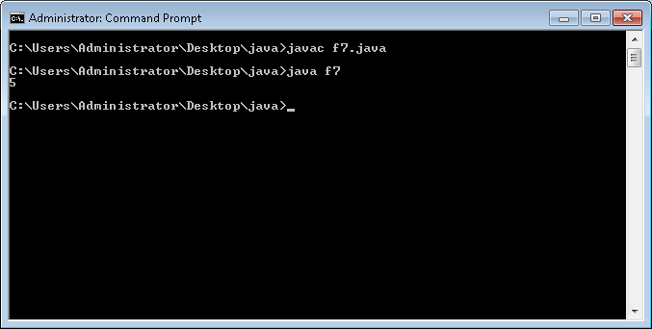
JAVA Exception Handling

Slide 57
Example-2
class TestFinallyBlock{
public static void main(String args[]){
try{
int data=25/0;
System.out.println(data);
System.exit(0);
}
catch(ArithmeticException e){System.out.println(e);}
finally{
System.out.println("finally block is always executed");}
System.out.println("rest of the code...");
}
}
JAVA Exception Handling

Slide 58
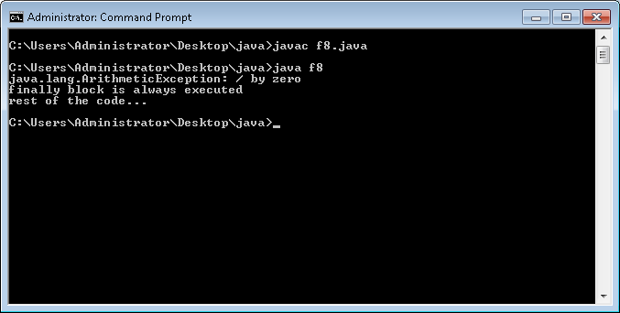
JAVA Exception Handling

Slide 59
Case-2
Output:
Exception in thread "main" java.lang.ArithmeticException: / by zero
class TestFinallyBlock{
public static void main(String args[]){
System.out.println(25/0);
try{
System.out.println(“try block”);
}
catch(ArithmeticException e){System.out.println(e);}
finally{
System.out.println("finally block is always executed");}
System.out.println("rest of the code...");
}
}
JAVA Exception Handling

Slide 60
Will it Compile?
Output:
error: 'try' without 'catch', 'finally' or resource declarations
class TestFinallyBlock{
public static void main(String args[]){
try{
System.out.println(“try block”);
}
System.out.println(25/0);
catch(ArithmeticException e){System.out.println(e);}
finally{
System.out.println("finally block is always executed");}
System.out.println("rest of the code...");
}
}
JAVA Exception Handling

Slide 61
Exception Methods
To print the exception information, we have 3 methods
toString()
getMessage()
printStackTrace()
JAVA Exception Handling

Slide 62
toString()
class TestFinallyBlock{
public static void main(String args[]){
try{
int data=25/0;
System.out.println(data);
}
catch(ArithmeticException e){
System.out.println(e.toString());
}
finally{
System.out.println("finally block is always executed");}
}
}
Output:
java.lang.ArithmeticException: / by zero
finally block is always executed
JAVA Exception Handling

Slide 63
getMessage()
class TestFinallyBlock{
public static void main(String args[]){
try{
int data=25/0;
System.out.println(data);
}
catch(ArithmeticException e){
System.out.println(e.getMessage());
}
finally{
System.out.println("finally block is always executed");}
}
}
Output:
/ by zero
finally block is always executed
JAVA Exception Handling

Slide 64
printStackTrace()
class TestFinallyBlock{
public static void main(String args[]){
try{
int data=25/0;
System.out.println(data);
}
catch(ArithmeticException e){
e.printStackTrace();
}
finally{
System.out.println("finally block is always executed");}
}
}
Output:
finally block is always executed java.lang.ArithmeticException: / by zero
JAVA Exception Handling

Slide 65
printStackTrace()
public class MyClass {
void m1()
{
m2();
}
void m2()
{
m3();
}
P.S.V.M() {
new MyClass().m1();
}
}
void m3()
{
try{
int data=25/0;
System.out.println(data);
}
catch(ArithmeticException e){
e.printStackTrace();
}
finally{
System.out.println("finally block is always executed");
}
}
JAVA Exception Handling

Slide 66
Output look like
finally block is always executed
java.lang.ArithmeticException: / by zero
at MyClass.m3(MyClass.java:13)
at MyClass.m2(MyClass.java:8)
at MyClass.m1(MyClass.java:4)
at MyClass.main(MyClass.java:28)
JAVA Exception Handling

Slide 67
printStackTrace()
printStackTrace() helps the programmer to understand where the actual problem occurred. It helps to trace the exception.
It is printStackTrace() method of Throwable class inherited by every exception class.
This method prints the same message of e object and also the line number where the exception occurred.
JAVA Exception Handling

Slide 68
Second approach of exception handling
throws
JAVA Exception Handling

Slide 69
throws
Throws keyword is delegating exception responsibility to caller method.
Syntax
return_type method_name() throws exception_class_name{
//method code
}
JAVA Exception Handling

Slide 70
Which type of exception should be declared?
Only checked exception
Why?
Checked exception are not in our control
JAVA Exception Handling

Slide 71
Advantage of Java throws keyword
Now Checked Exception can be propagated (forwarded in call stack).
It provides information to the caller of the method about the exception.
JAVA Exception Handling

Slide 72
Example
public class MyClass {
void m1()
{
m2();
}
void m2()
{
m3();
}
P.S.V.M() {
new MyClass().m1();
}
}
void m3()
{
S.O.P(“sleeping mode”);
Thread.sleep(3000);
S.O.P(“awake mode”);
}
Output-
error: unreported exception InterruptedException; must be caught or declared to be thrown
Thread.sleep(3000);
JAVA Exception Handling

Slide 73
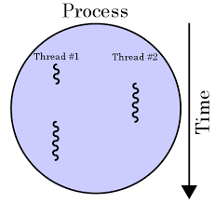
JAVA Exception Handling

Slide 74
Handle it by try-catch
public class MyClass {
void m1()
{
m2();
}
void m2()
{
m3();
}
P.S.V.M() {
new MyClass().m1();
}
}
void m3()
{
try{
S.O.P(“sleeping mode”);
Thread.sleep(3000);
S.O.P(“awake mode”);
}
catch(InterruptException i)
{
i.printStackTrace();
}
}
Output-
sleeping mode
awake mode
JAVA Exception Handling

Slide 75
How to use throws keyword here?
If m3() method is not able to handle the Interrupted exception then it will throws to the m2() method.
Bcs m2() is caller method
JAVA Exception Handling

Slide 76
Handle it by throws
public class MyClass {
void m1()
{
m2();
}
void m2()
{
try { m3(); }
catch(InterruptException i)
{
i.printStackTrace();
}
}
P.S.V.M() {
new MyClass().m1();
}
}
void m3() throws InterruptedException
{
S.O.P(“sleeping mode”);
Thread.sleep(3000);
S.O.P(“awake mode”);
}
Output-
sleeping mode
awake mode
JAVA Exception Handling

Slide 77
If m2() method is not able to handle the Interrupted exception then it will throws to the m1() method.
JAVA Exception Handling

Slide 78
Propagate throws
public class MyClass {
void m1()
{
try{ m2(); }
catch(InterruptException i)
{
i.printStackTrace();
}
}
void m2() throws InterruptedException
{
m3();
}
P.S.V.M() {
new MyClass().m1();
}
}
void m3() throws InterruptedException
{
S.O.P(“sleeping mode”);
Thread.sleep(3000);
S.O.P(“awake mode”);
}
Output-
sleeping mode
awake mode
JAVA Exception Handling

Slide 79
If m1() method is not able to handle the Interrupted exception then it will throws to the main()method.
JAVA Exception Handling

Slide 80
Propagate throws
public class MyClass {
void m1() throws InterruptedException
{
m2();
}
void m2() throws InterruptedException
{
m3();
}
P.S.V.M() {
try{
new MyClass().m1();
}
catch(InterruptException i)
{
i.printStackTrace();
}
}
}
void m3() throws InterruptedException
{
S.O.P(“sleeping mode”);
Thread.sleep(3000);
S.O.P(“awake mode”);
}
Output-
sleeping mode
awake mode
JAVA Exception Handling

Slide 81
If main() method is not able to handle the Interrupted exception then it will throws to the JVM.
JAVA Exception Handling

Slide 82
Propagate throws
public class MyClass {
void m1() throws InterruptedException
{
m2();
}
void m2() throws InterruptedException
{
m3();
}
P.S.V.M() throws InterruptedException
{
new MyClass().m1();
}
}
void m3() throws InterruptedException
{
S.O.P(“sleeping mode”);
Thread.sleep(3000);
S.O.P(“awake mode”);
}
Output-
sleeping mode
awake mode
JAVA Exception Handling

Slide 83
Now discuss last keyword
throw
JAVA Exception Handling

Slide 84
Purpose of throw keyword
Understand it with example-
Arithmetic Exception-
1. predefine exception
2. JVM is creating object of Arithmetic Exception
3. JVM is printing exception information:
/ by zero
JAVA Exception Handling

Slide 85
What about user define ArithmeticException?
User define exception
User define information
JAVA Exception Handling

Slide 86
How to create user object with information?
new ArithmeticException(“CHARUSAT / by zero”);
JAVA Exception Handling

Slide 87
How to handover user object to JVM?
By using throw keyword
throw new ArithmeticException(“CHARUSAT / by zero”);
JAVA Exception Handling

Slide 88
Example-1
public class MyClass {
public static void main(String args[]) {
System.out.println("user define message");
throw new ArithmeticException("CHARUSAT / by zero");
}
}
Output-
user define message
Exception in thread "main" java.lang.ArithmeticException: CHARUSAT / by zero
JAVA Exception Handling

Slide 89
Example-2
public class MyClass {
public static void main(String args[]) {
System.out.println("user define message");
try{
throw new Exception();
}
catch(Exception e){
System.out.println(e.getMessage());
}
}
}
Output-
user define message
null
JAVA Exception Handling

Slide 90
Example-3
public class MyClass {
public static void main(String args[]) {
System.out.println("user define message");
try{
throw new Exception("base exception class message");
}
catch(Exception e){
System.out.println(e.getMessage());
}
}
}
Output-
user define message
base exception class message
JAVA Exception Handling

Slide 91
Example-4
public class MyClass {
public static void main(String args[]) {
System.out.println("user define message");
throw new ArithmeticException("CHARUSAT / by zero");
System.out.println(“rest of the code…");
}
}
Output-
error: unreachable statement
System.out.println("user define message");
JAVA Exception Handling

Slide 92
Reason
The lines after a ‘throw’ will never get executed.
We only use throw when we want to specify a restriction to the application we're working on.
anything after throw statement will not execute
JAVA Exception Handling

Slide 93
How to create user define exception?
JAVA Exception Handling

Slide 94
Two Types
User define checked exception
a) default constructor approach
b) parameterized constructor approach
2. User define unchecked exception
a) default constructor approach
b) parameterized constructor approach
JAVA Exception Handling

Slide 95
1. create user defined checked exception by using default constructor approach
create the exception class first
use the exception class in project
JAVA Exception Handling

Slide 96
Example-1
class MyException extends Exception{
// default constructor generated by compiler
}
public class MyClass {
public static void main(String args[]) {
try{
throw new MyException();
}
catch(MyException e){
System.out.println(e.getMessage());
System.out.println(“exception caught successfully”);
}
}}
Output-
null
exception caught successfully
JAVA Exception Handling

Slide 97
2. create user defined checked exception by using parameterized constructor approach
JAVA Exception Handling

Slide 98
Example-1
class MyException extends Exception{
MyException(String s) { super(s); }
}
Output-
Java user defined exception
exception caught successfully
public class MyClass {
public static void main(String args[]) {
try{
throw new MyException(“Java user defined exception”);
}
catch(MyException e){
System.out.println(e.getMessage());
System.out.println(“exception caught successfully”);
}
}}
JAVA Exception Handling

Slide 99
No. | throw | throws
1) | Java throw keyword is used to explicitly throw an exception. | Java throws keyword is used to declare an exception.
2) | Checked exception cannot be propagated using throw only. | Checked exception can be propagated with throws.
3) | Throw is followed by an instance. | Throws is followed by class.
4) | Throw is used within the method. | Throws is used with the method signature.
5) | You cannot throw multiple exceptions. | You can declare multiple exceptions e.g. public void method()throws IOException,SQLException.
JAVA Exception Handling

Slide 100
Homework-1
Design an InvalidAgeException class and throw the exception if age is less then 18.
The exception will print the information
“not eligible for voting in 2019”
JAVA Exception Handling

Slide 101
class InvalidAgeException extends Exception{
InvalidAgeException(String s){
super(s);
}
}
class custom{
static void validate(int age)throws InvalidAgeException{
if(age<18)
throw new InvalidAgeException("not valid");
else
System.out.println("welcome to vote");
}
public static void main(String args[]){
try{
validate(13);
}catch(Exception m){System.out.println("Exception occured: "+m);}
System.out.println("rest of the code...");
}
}
JAVA Exception Handling

Slide 102
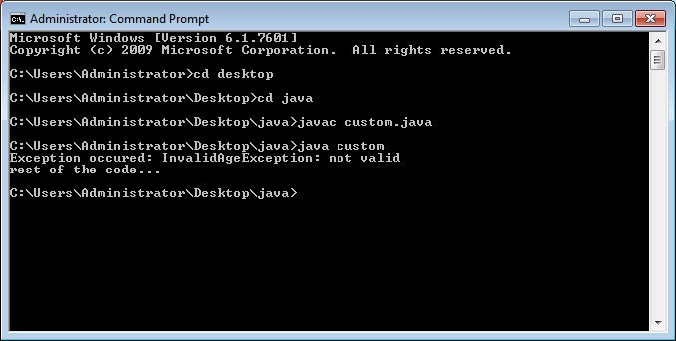
JAVA Exception Handling

Slide 103
Homework-2
create user defined unchecked exception by using default constructor & parameterized approach
JAVA Exception Handling

Slide 104
class UserDefinedException extends RuntimeException {
UserDefinedException(String s) {
super(s);
}
}
JAVA Exception Handling

Slide 105
Any Question??

Slide 106
Q-01
What is the output of this program?
class exception_handling
{
public static void main(String args[])
{
try
{
System.out.print("Hello" + " " + 1 / 0);
}
catch(ArithmeticException e)
{
System.out.print("World");
}
}
}
JAVA Exception Handling

Slide 107
Q-02
Given:
try { int x = Integer.parseInt("two"); }
Which could be used to create an appropriate catch block? (Choose all that apply.)
Options are-
A. ClassCastException
B. IllegalStateException
C. NumberFormatException
D. IllegalArgumentException
E. ExceptionInInitializerError
F. ArrayIndexOutOfBoundsException
JAVA Exception Handling

Slide 108
3
Which of these keywords is used to manually throw an exception? a) try b) finally c) throw d) catch
JAVA Exception Handling

Slide 109
4
What is the output of this program?
class exception_handling
{
public static void main(String args[])
{
try
{
int a, b;
b = 0;
a = 5 / b;
System.out.print("A");
}
catch(ArithmeticException e)
{
System.out.print("B");
}
}
}
JAVA Exception Handling

Slide 110
5. What is the output here
class exception_handling
{
public static void main(String args[])
{
try
{
int a, b;
b = 0;
a = 5 / b;
System.out.print("A");
}
catch(ArithmeticException e)
{
System.out.print("B");
}
finally
{
System.out.print("C");
}
}
}
JAVA Exception Handling

Slide 111
Q-06
try
{
int x = 0;
int y = 5 / x;
}
catch (Exception e)
{
System.out.println("Exception");
}
catch (ArithmeticException ae)
{
System.out.println(" Arithmetic Exception");
}
System.out.println("finished");
A.Finished
B. Exception
C. Compilation fails.
D. Arithmetic Exception
JAVA Exception Handling

Slide 112
public class X
{
public static void main(String [] args)
{
try
{
badMethod();
System.out.print("A");
}
catch (Exception ex)
{
System.out.print("B");
}
finally
{
System.out.print("C");
}
System.out.print("D");
}
public static void badMethod()
{
throw new Error(); /* Line 22 */
}
}
JAVA Exception Handling

Slide 113
ABCD
Compilation fails.
C is printed before exiting with an error message.
BC is printed before exiting with an error message.
JAVA Exception Handling

Slide 114
public class X {
public static void main(String [] args)
{ try
{ badMethod();
System.out.print("A");
}
catch (RuntimeException ex) /* Line 10 */
{ System.out.print("B");
}
catch (Exception ex1)
{
System.out.print("C");
}
finally {
System.out.print("D");
}
System.out.print("E");
}
public static void badMethod()
{
throw new RuntimeException();
} }
JAVA Exception Handling

Slide 115
BD
BCD
BDE
BCDE
JAVA Exception Handling

Slide 116
https://www.aliensbrain.com/quiz_events/0
JAVA Exception Handling

Slide 117
Wrapper class
The wrapper class in Java provides the mechanism to convert primitive into object and object into primitive.
Following are the features used for this:
Autoboxing
unboxing
The automatic conversion of primitive into an object is known as autoboxing and vice-versa unboxing.
JAVA Exception Handling

Slide 118
Use of Wrapper classes in Java
Java is an object-oriented programming language, so we need to deal with objects many times like in Collections, Serialization, Synchronization, etc.
JAVA Exception Handling

Slide 119
Change the value in Method: Java supports only call by value. So, if we pass a primitive value, it will not change the original value. But, if we convert the primitive value in an object, it will change the original value.
Synchronization: Java synchronization works with objects in Multithreading.
Primitive Type | Wrapper class
boolean | Boolean
char | Character
byte | Byte
short | Short
int | Integer
long | Long
float | Float
double | Double
JAVA Exception Handling

Slide 120
Autoboxing
The automatic conversion of primitive data type into its corresponding wrapper class is known as autoboxing, for example, byte to Byte, char to Character, int to Integer, long to Long, float to Float, boolean to Boolean, double to Double, and short to Short.
JAVA Exception Handling

Slide 121
//Java program to convert primitive into objects
//Autoboxing example of int to Integer
public class WrapperExample1{
public static void main(String args[]){
//Converting int into Integer
int a=20;
Integer i=Integer.valueOf(a);//converting int into Integer explicitly
Integer j=a;//autoboxing, now compiler will write Integer.valueOf(a) internally
System.out.println(a+" "+i+" "+j);
}}
Output:20 20 20
JAVA Exception Handling

Slide 122
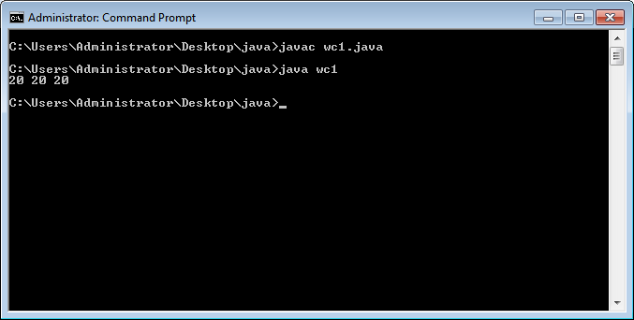
JAVA Exception Handling

Slide 123
Unboxing
The automatic conversion of wrapper type into its corresponding primitive type is known as unboxing. It is the reverse process of autoboxing. Since Java 5, we do not need to use the intValue() method of wrapper classes to convert the wrapper type into primitives.
JAVA Exception Handling

Slide 124
//Java program to convert object into primitives
//Unboxing example of Integer to int
public class WrapperExample2{
public static void main(String args[]){
//Converting Integer to int
Integer a=new Integer(3);
int i=a.intValue();//converting Integer to int explicitly
int j=a;//unboxing, now compiler will write a.intValue() internally
System.out.println(a+" "+i+" "+j);
}}
JAVA Exception Handling

Slide 125
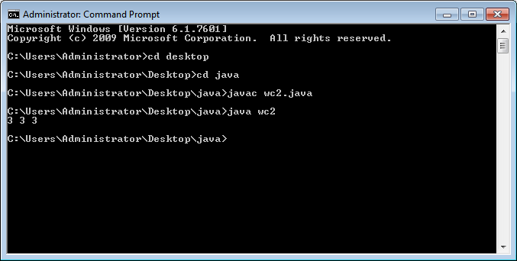
JAVA Exception Handling

